Slide 1
Domain-specific
Languages
Javier Luis Cánovas Izquierdo
javier.canovas@inria.fr
February 2013

Slide 2
Outline
Languages
Domain-Specific Languages
Xtext
GMF

Slide 3
Outline
Languages
Domain-Specific Languages
Xtext
GMF

Slide 4
What is
a language

Slide 5
What is a language?
From Wikipedia:
Language is the human capacity for acquiring and using complex systems of communication, and a language is any specific example of such a system.

Slide 6
What is a language?
From Wikipedia:
Language is the human capacity for acquiring and using complex systems of communication, and a language is any specific example of such a system.
Why?
How?

Slide 7
What is a language?
From Wikipedia:
Language is the human capacity for acquiring and using complex systems of communication, and a language is any specific example of such a system.
Why?
How?

Slide 8
What is a language?
From Wikipedia:
Language is the human capacity for acquiring and using complex systems of communication, and a language is any specific example of such a system.
Why?
How?

Slide 9
What is a language?
Table

Slide 10
What is a language?
From the formal language theory:
A language is a set of linguistic utterances, (i.e., words), also called strings or sentences, which are composed by a set of symbols of an alphabet.
A grammar is the set of structural rules that governs the composition of linguistic utterances

Slide 11
What is a language?
From the formal language theory:
A language is a set of linguistic utterances, (i.e., words), also called strings or sentences, which are composed by a set of symbols of an alphabet.
A grammar is the set of structural rules that governs the composition of linguistic utterances
Why?
How?

Slide 12
What is a language?
From the formal language theory:
A language is a set of linguistic utterances, (i.e., words), also called strings or sentences, which are composed by a set of symbols of an alphabet.
A grammar is the set of structural rules that governs the composition of linguistic utterances
Why?
How?

Slide 13
What is a language?
From the formal language theory:
A language is a set of linguistic utterances, (i.e., words), also called strings or sentences, which are composed by a set of symbols of an alphabet.
A grammar is the set of structural rules that governs the composition of linguistic utterances
Why?
How?

Slide 14
A grammar?
machineDefinition:
MACHINE OPEN_SEP stateList
transitionList CLOSE_SEP;
stateList:
state (COMMA state)*;
state:
ID_STATE;
transitionList:
transition (COMMA transition)*;
transition:
ID_TRANSITION OPEN_SEP
state state CLOSE_SEP;
MACHINE: ‘machine’;
OPEN_SEP: ‘{’;
CLOSE_SEP: ‘{’;
COMMA: ‘,’;
ID_STATE: ‘S’ ID;
ID_TRANSITION: ‘T’ (0..9)+;
ID: (a..zA..Z_) (a..zA..Z0..9)*;
machine {
SOne STwo
T1 { SOne STwo }
}
machine {
S_first S_second
T1 { S_first S_second}
T1 { S_second S_first }
}
machine {
SA SB SC SD
T1 { SA SD }
T2 { SA SB }
T3 { SB SC }
T4 { SB SA }
}

Slide 15
Languages in
engineering

Slide 16
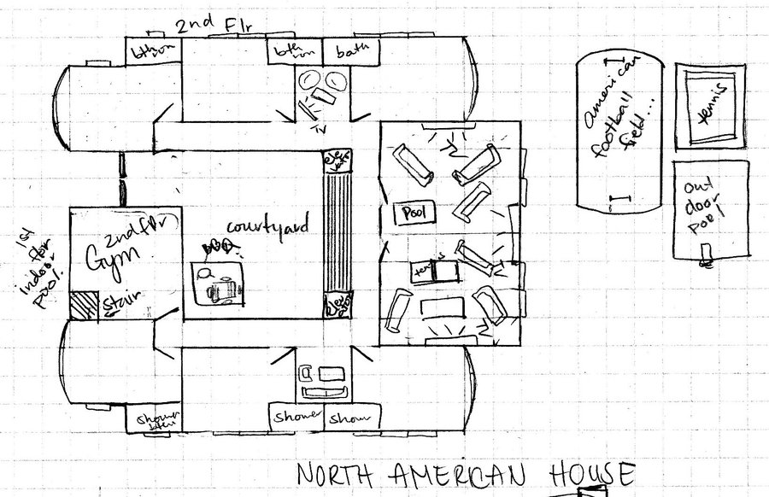
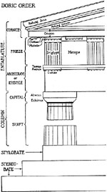
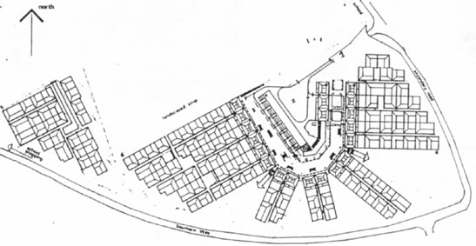
Architecture

Slide 17
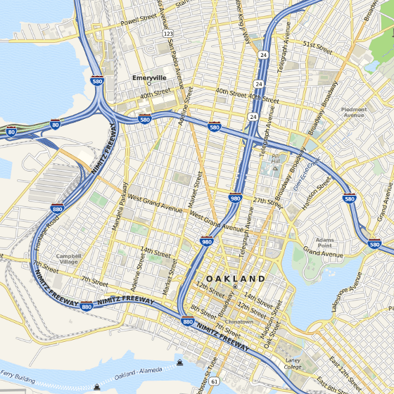
Cartography

Slide 18
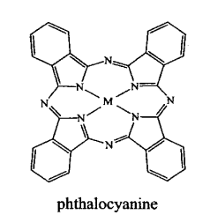
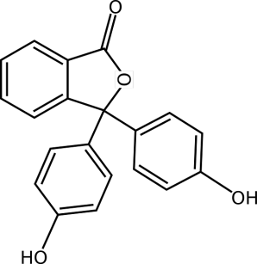
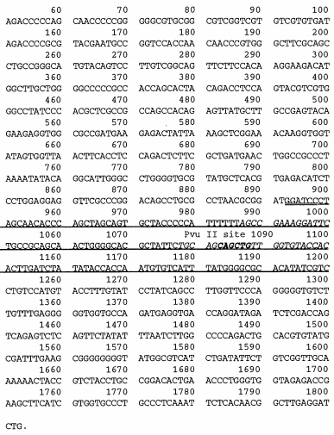
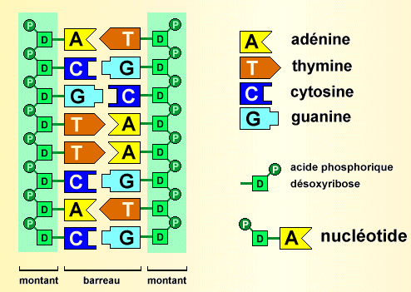
Biology

Slide 19
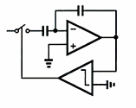
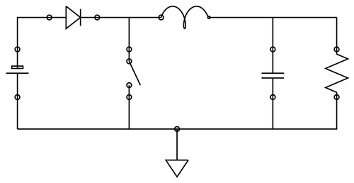
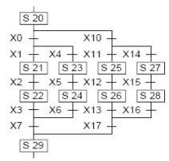
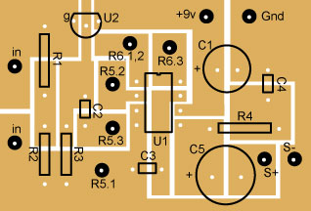
Electronics

Slide 20
Languages in Computer Science

Slide 21
GPLs
Java
C
Python
Delphi
class HelloWorldApp {
public static void main(String[] args) {
System.out.println("Hello World!"); }
}
program ObjectPascalExample;
type
THelloWorld = object
procedure Put;
end;
var
HelloWorld: THelloWorld;
procedure THelloWorld.Put;
begin
WriteLn('Hello, World!');
end;
begin
New(HelloWorld);
HelloWorld.Put;
Dispose(HelloWorld);
end.
#include <stdio.h>
int main(void)
{
printf("hello, world\n");
}
print("Hello world")

Slide 22
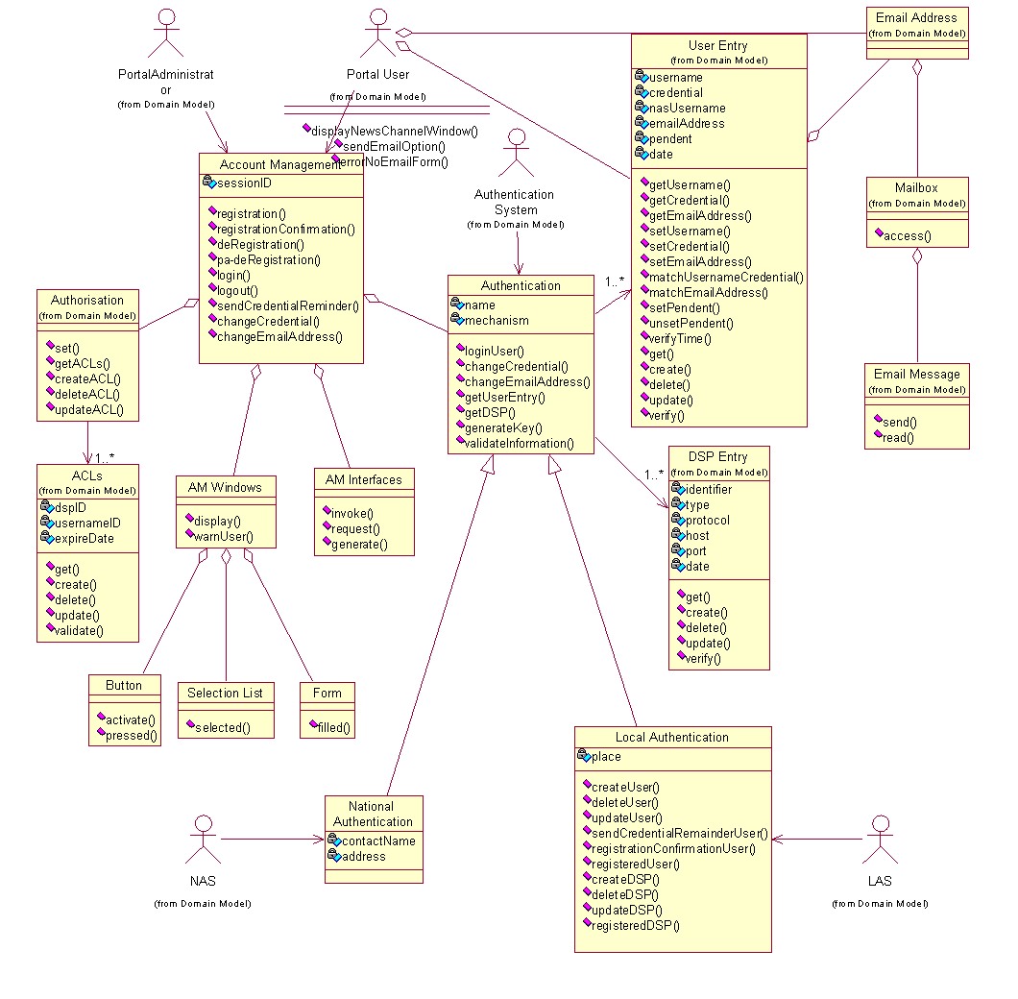
GPLs
UML

Slide 23
DSLs
SQL
HTML
CSS
LaTeX
CREATE TABLE Employee (
id INT NOT NULL IDENTITY (1,1) PRIMARY KEY,
name VARCHAR(50),
surname VARCHAR(50),
address VARCHAR(255),
city VARCHAR(60),
telephone VARCHAR(15),
)
body {
text-align: left;
font-family: helvetica, sans-serif;
}
h1 {
border: 1px solid #b4b9bf;
font-size: 35px;}
\ifthenelse{\boolean{showcomments}}
{\newcommand{\nb}[2]{
\fcolorbox{gray}{yellow}{
\bfseries\sffamily\scriptsize#1
}
{\sf\small\textit{#2}}
}
\newcommand{\version}{\scriptsize$-$working$-$}
}
{\newcommand{\nb}[2]{}
\newcommand{\version}{}
}
<html>
<head>
<title>Example</title>
</head>
<body>
<p>Example</p>
</body>
</html>

Slide 24
DSLs
OCL
ATL
employees->includes(#dent)
self.questions->size
self.employer->size
self.employee->select (v | v.wages>10000 )->size
Student.allInstances
->forAll( p1, p2 |
p1 <> p2 implies p1.name <> p2.name )
MiniUML
package Courses {
class Student {
attribute studentid : number key
attribute firstName : string
attribute lastName : string
}
class Course {
attribute name : string key
attribute description : string optional
attribute ects: number
}
}
unique lazy rule customFuncCall {
from
src : TupleType(class1 : MM!EClass,
class2 : MM!EClass)
to
t : FOL!CustomFuncCall(
name <- src.class1.name,
declaration <- src.class1,
arguments <- Sequence{thisModule.variable(src)}
)
}

Slide 25
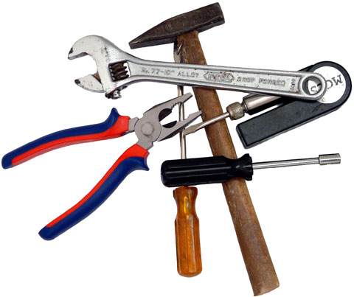
GPLs vs DSLs

Slide 26
GPLs vs DSLs
A GPL provides notations that are used to describe a computation in a human-readable form that can be translated into a machine-readable representation.
A GPL is a formal notation that can be used to describe problem solutions in a precise manner.
A GPL is a notation that can be used to write programs.
A GPL is a notation for expressing computation.
A GPL is a standardized communication technique for expressing instructions to a computer. It is a set of syntactic and semantic rules used to define computer programs.

Slide 27
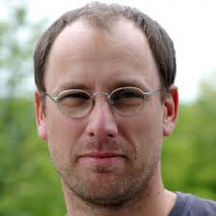
GPLs vs DSLs
The boundary isn’t as clear as it could be. Domain-specificity is not black-and-white, but instead gradual: a language is more or less domain specific

Slide 28
GPLs vs DSLs
The boundary isn’t as clear as it could be. Domain-specificity is not black-and-white, but instead gradual: a language is more or less domain specific

Slide 29
Outline
Languages
Domain-Specific Languages
Xtext
GMF

Slide 30
DSL
The big picture
Anatomy
Development
Actors
Best practices
Worst practices
What is a DSL? Why?

Slide 31
DSL
The big picture
Anatomy
Development
Actors
Best practices
Worst practices
What is a DSL? Why?

Slide 32
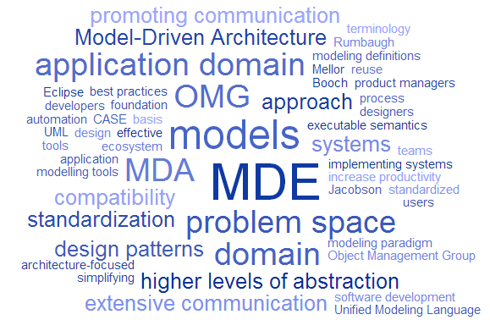
The big picture
Domain-Specific Languages?

Slide 33
Concepts

Slide 34
Concepts

Slide 35
Concepts

Slide 36
Concepts

Slide 37
DSL
The big picture
Anatomy
Development
Actors
Best practices
Worst practices
What is a DSL? Why?

Slide 38
What is a DSL
In general:
Language specially designed to perform a task in a certain domain

Slide 39
What is a DSL
In general:
Language specially designed to perform a task in a certain domain
In the context of computer science:
A formal processable language targeting at a specific viewpoint or aspect of a software system.
It's semantics flexibility and notation is designed in order to support working with that viewpoint as good as possible

Slide 40
And the rest of languages?
SQL, HTML
C, Cobol
Assembler
Machine
DSLs

Slide 41
Why DSLs?
Abstraction Gap
Assembler
C, Java
DSLs
Problem
Domain
Solution
Domain

Slide 42
What is offered?
Higher abstractions
Avoid redundancy
Separation of concerns
Use domain concepts

Slide 43
What are the advantages?
Benefits
Quality
V&V
Communication
Domain Expert
No Overhead
Platform Independent
Productivity

Slide 44
What for?
Utility
Architecture
Full Technical
Application
Requirements
Analysis
Product Line
Generation of interfaces
Generation of WSDL
Set up of skeleton projects

Slide 45
What for?
Utility
Architecture
Full Technical
Application
Requirements
Analysis
Product Line
Architecture-Definition Languages
AUTOSAR

Slide 46
What for?
Utility
Architecture
Full Technical
Application
Requirements
Analysis
Product Line
Model transformation languages: ATL, Acceleo
Constraints language: OCL

Slide 47
What for?
Utility
Architecture
Full Technical
Application
Requirements
Analysis
Product Line
Describe a cooling algorithm in refrigerators
Configure hearing aids
Insurance mathematics

Slide 48
What for?
Utility
Architecture
Full Technical
Application
Requirements
Analysis
Product Line
Pseudo-structured natural languages

Slide 49
What for?
Utility
Architecture
Full Technical
Application
Requirements
Analysis
Product Line
Mathematical formalisms

Slide 50
What for?
Utility
Architecture
Full Technical
Application
Requirements
Analysis
Product Line
Composition languages
Workflow languages

Slide 51
What is a domain?
Inductive / Bottom-up
The domain is defined in terms of existing software used to address a particular class of problems or products
A domain D is identified as a set of programs with common characteristics or similar purpose
Often such domains do not exists outside the realm of software
Special case when we define a domain as a subset of programs written in a specific language (idiom)
A domain D is a body of knowledge for which we want to provide some form of software support
Much harder to address using DSLs because of the need to understand precisely the nature of the domain and identify interesting programs in such domain
The domain is defined as a body of knowledge about the real world, i.e., outside the realm of software
Deductive / top-down

Slide 52
but… how?

Slide 53
DSL
The big picture
Anatomy
Development
Actors
Best practices
Worst practices
What is a DSL? Why?

Slide 54
Anatomy
DSL
Abstract Syntax
Concrete Syntax
Semantics
Textual
Graphical
Concepts & relationships
Well-formed rules
Denotational
Pragmatic
Translational
Operational

Slide 55
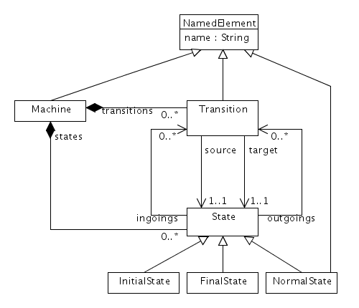
A first look
Abstract Syntax
Describes the structure of the language and the way the different primitives can be combined together, independently of any particular representation or encoding.
Concrete Syntax
Describes specific representations of the modeling language, covering encoding and/or visual appearance
Semantics
Describing the meaning of the elements defined in the language and the meaning of the different ways of combining them.

Slide 56
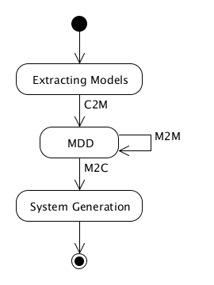
A first look
Abstract Syntax
Describes the structure of the language and the way the different primitives can be combined together, independently of any particular representation or encoding.
Concrete Syntax
Describes specific representations of the modeling language, covering encoding and/or visual appearance
Semantics
Describing the meaning of the elements defined in the language and the meaning of the different ways of combining them.

Slide 57
A first look
Abstract Syntax
Describes the structure of the language and the way the different primitives can be combined together, independently of any particular representation or encoding.
Concrete Syntax
Describes specific representations of the modeling language, covering encoding and/or visual appearance
Semantics
Describing the meaning of the elements defined in the language and the meaning of the different ways of combining them.
How this is executed?

Slide 58
Anatomy
DSL
Abstract Syntax
Concrete Syntax
Semantics
Textual
Graphical
Concepts & relationships
Well-formed rules
Denotational
Pragmatic
Translational
Operational

Slide 59
Abstract Syntax
Metamodelling techniques
UML notation
Concept => Class
Property => Attribute
Contaiment Relationship => Composite Association
Relationship => Association
Specialization => Inheritance
Package => Package
Well-formed rules
OCL expressions
context Transition
inv: self.source <> self.target
context Machine
inv: self.states
->exists(s | s.oclIsKinfOf(InitialState))

Slide 60
Anatomy
DSL
Abstract Syntax
Concrete Syntax
Semantics
Textual
Graphical
Concepts & relationships
Well-formed rules
Denotational
Pragmatic
Translational
Operational

Slide 61
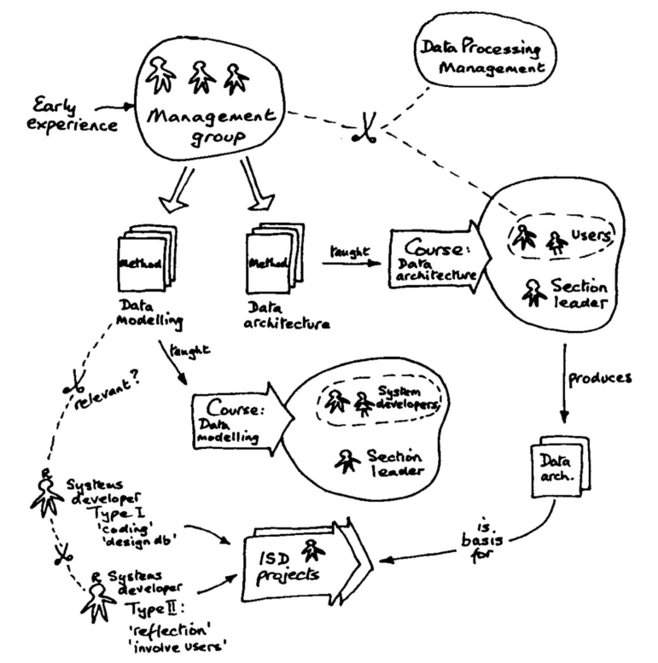
Concrete Syntax
Textual
Graphical

Slide 62
Concrete Syntax
Textual

Slide 63
Concrete Syntax
Textual
Graphical
digraph Modernization {
Start -> ExtractingModels;
ExtractingModels -> MDD [label="C2M"];
MDD -> MDD [label="M2M"];
MDD -> SystemGeneration [label="M2C"];
SystemGeneration -> End;
Start
[shape=point,width=0.2,label=""];
ExtractingModels
[label="Extracting Models",shape=ellipse];
MDD
[shape=ellipse];
SystemGeneration
[label="System Generation",shape=ellipse];
End
[shape=doublecircle,label="",width=0.2,
fillcolor=black,style=filled];
}

Slide 64
Textual Syntax
Grammar
Metamodel
conforms To
conforms To
MachineA
MachineC
Model A
Model C
MachineB
Model B
Grammarware
Modelware

Slide 65
Textual Syntax
Grammar
Metamodel
conforms To
conforms To
MachineA
MachineC
Model A
Model C
MachineB
Model B
Grammarware
Modelware

Slide 66
Textual Syntax
machineDefinition:
MACHINE OPEN_SEP stateList
transitionList CLOSE_SEP;
stateList:
state (COMMA state)*;
state:
ID_STATE;
transitionList:
transition (COMMA transition)*;
transition:
ID_TRANSITION OPEN_SEP
state state CLOSE_SEP;
MACHINE: ‘machine’;
OPEN_SEP: ‘{’;
CLOSE_SEP: ‘{’;
COMMA: ‘,’;
ID_STATE: ‘S’ ID;
ID_TRANSITION: ‘T’ (0..9)+;
ID: (a..zA..Z_) (a..zA..Z0..9)*;
conforms To
machine {
SOne STwo
T1 { SOne STwo }
}

Slide 67
Textual Syntax
machineDefinition:
MACHINE OPEN_SEP stateList
transitionList CLOSE_SEP;
stateList:
state (COMMA state)*;
state:
ID_STATE;
transitionList:
transition (COMMA transition)*;
transition:
ID_TRANSITION OPEN_SEP
state state CLOSE_SEP;
MACHINE: ‘machine’;
OPEN_SEP: ‘{’;
CLOSE_SEP: ‘{’;
COMMA: ‘,’;
ID_STATE: ‘S’ ID;
ID_TRANSITION: ‘T’ (0..9)+;
ID: (a..zA..Z_) (a..zA..Z0..9)*;
conforms To
machine {
SOne STwo
T1 { SOne STwo }
}

Slide 68
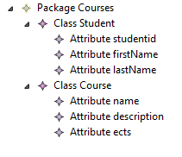
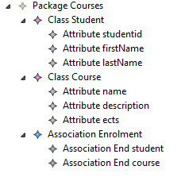
You have already work with one
package Courses {
class Student {
attribute studentid : number key
attribute firstName : string
attribute lastName : string
}
class Course {
attribute name : string key
attribute description : string optional
attribute ects: number
}
}
sintax of
conforms To
Ecore MM
package Courses {
class Student {
attribute studentid : number key
attribute firstName : string
attribute lastName : string
}
class Course {
attribute name : string key
attribute description : string optional
attribute ects: number
}
association Enrolment {
end student : Student [1..*]
end course : Course [0..*]
}
}
conforms To
sintax of

Slide 69
Textual Syntax
Grammar-oriented (Xtext)
Grammar
Metamodel
conforms To
conforms To
Graph B
Model A

Slide 70
Xtext
Model-Driven framework to develop textual DSLs
Is part of Eclipse Modeling Project
Is part of a DSL tooling initally called Open Architecture Ware
Main features:
Syntax Coloring
Content Assist
Validation and Quick Fixes
Advanced Java Integration
Integration with other Eclipse tools

Slide 71
Textual Syntax
Metamodel-oriented (EMFText)
Grammar
Metamodel
conforms To
conforms To
Graph B
Model A

Slide 72
EMFText
Model-Driven framework to develop textual DSLs
Developed as a Eclipse plugin
Main features:
Syntax Coloring
Content Assist
Validation and Quick Fixes
Reference resolving mechanism

Slide 73
EMFText
Model-Driven framework to develop textual DSLs
Developed as a Eclipse plugin
Main features:
Syntax Coloring
Content Assist
Validation and Quick Fixes
Reference resolving mechanism

Slide 74
Graphical Syntax
A draw is better than a long explanation
digraph Modernization {
Start -> ExtractingModels;
ExtractingModels -> MDD [label="C2M"];
MDD -> MDD [label="M2M"];
MDD -> SystemGeneration [label="M2C"];
SystemGeneration -> End;
Start
[shape=point,width=0.2,label=""];
ExtractingModels
[label="Extracting Models",shape=ellipse];
MDD
[shape=ellipse];
SystemGeneration
[label="System Generation",shape=ellipse];
End
[shape=doublecircle,label="",width=0.2,
fillcolor=black,style=filled];
}

Slide 75
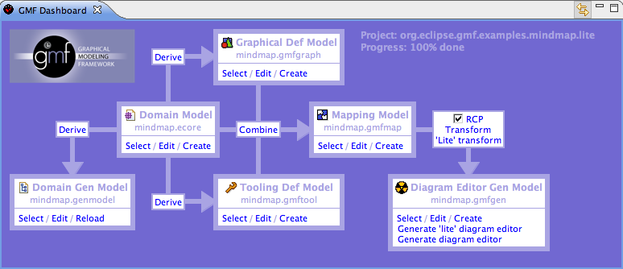
GMF
Graphical Modeling Framework
Model-Driven Framework to develop graphical editors based on EMF and GEF
GMF is part of Eclipse Modeling Project
Provides a generative component to create the DSL tooling
Provides a runtime infrastructure to facilitate the development of graphical DSLs

Slide 76
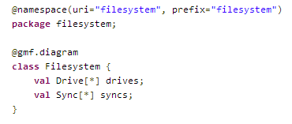
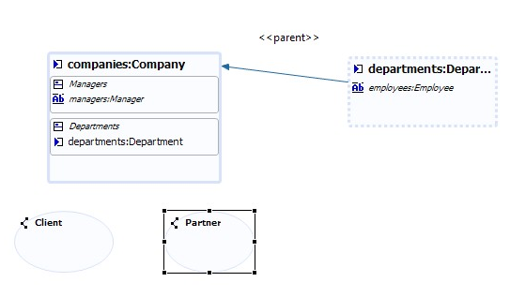
Alternatives
GMF can be too complex
EuGENia
Automatically generated GMF infrastructure
Lowers the entrance barrier for creating GMF editors
Provides textual DSLs and wizards to define the graphical DSL
GMF simple mapping editor
Graphical DSL to configure GMF
Generators for creating the required GMF infrastructure

Slide 77
Graphical vs. Textual
Success depends on how the notation fits the domain
class Person {
private String name;
private String name;
}
Person has (name, surname)
Person
name : string
surname : string

Slide 78
Graphical vs. Textual
Success depends on how the notation fits the domain
class Person {
private String name;
private String name;
}
Person has (name, surname)
Person
name : string
surname : string
Graphical DSLs are not always easier to understand

Slide 79
Graphical vs. Textual
Expression of common concerns simple and concise
class Person {
private String name;
private String name;
}
Person has (name, surname)

Slide 80
Graphical vs. Textual
Expression of common concerns simple and concise
class Person {
private String name;
private String name;
}
Person has (name, surname)
Providing sensible defaults
public class MyClass {
public void readStream(InputStream stream, boolean closeStreamAferReading) {
...
}
}
public class MyClass {
public void readStream(InputStream stream) {
readStream(stream, true);
}
public void readStream(InputStream stream, boolean closeStreamAferReading) {
...
}
}

Slide 81
Graphical vs. Textual
Verbosity for less common concerns
Person has (name, surname)
Person has (name, surname)
extension
name is String
surname is String
Tool support and limitations
Syntax highlighting
Outline
Auto-completion
Validation
Layout
…

Slide 82
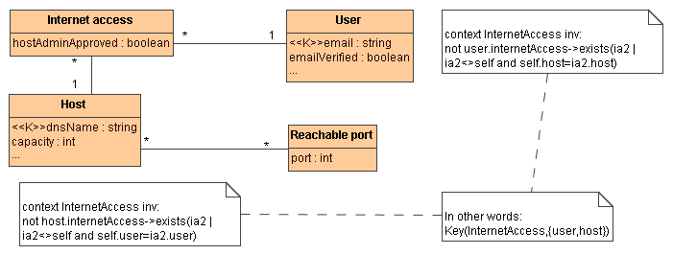
Graphical AND Textual

Slide 83
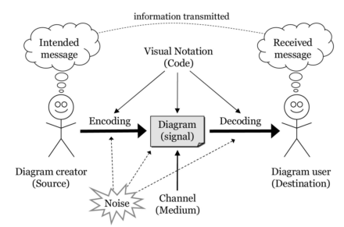
Recommendations

Slide 84
Recommendations
Physics of notations
Semiotic clarity
Perceptual Discriminality
Complexity Management
Semantics transparency
Cognitive Integration
Visual Expressiveness
Dual Coding
Graphic Economy
Cognitive Fit

Slide 85
Recommendations
Physics of notations
Semiotic clarity
Perceptual Discriminality
Complexity Management
Semantics transparency
Cognitive Integration
Visual Expressiveness
Dual Coding
Graphic Economy
Cognitive Fit
There should be a 1:1 correspondence between concepts and graphical symbols

Slide 86
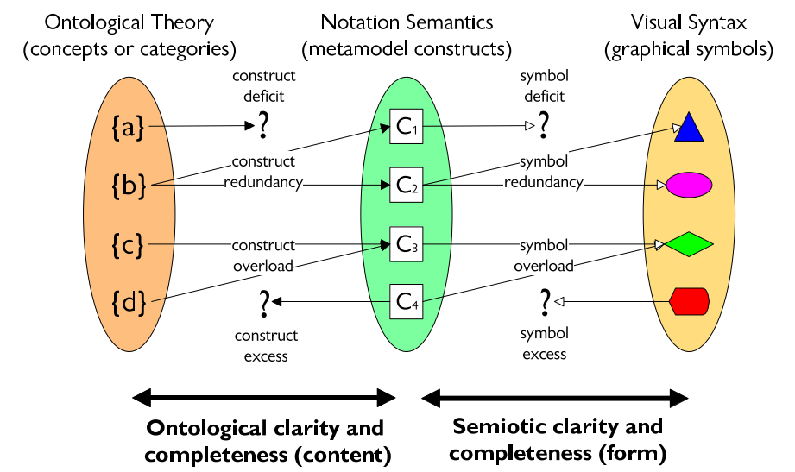
Recommendations
Physics of notations
Semiotic clarity
Perceptual Discriminality
Complexity Management
Semantics transparency
Cognitive Integration
Visual Expressiveness
Dual Coding
Graphic Economy
Cognitive Fit

Slide 87
Recommendations
Physics of notations
Semiotic clarity
Perceptual Discriminality
Complexity Management
Semantics transparency
Cognitive Integration
Visual Expressiveness
Dual Coding
Graphic Economy
Cognitive Fit
Different symbols should be clearly distinguishable from each other

Slide 88
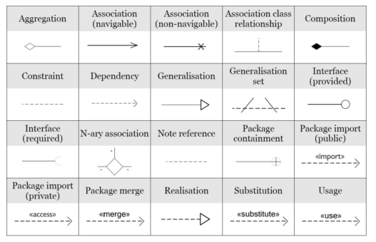
Recommendations
Physics of notations
Semiotic clarity
Perceptual Discriminality
Complexity Management
Semantics transparency
Cognitive Integration
Visual Expressiveness
Dual Coding
Graphic Economy
Cognitive Fit

Slide 89
Recommendations
Physics of notations
Semiotic clarity
Perceptual Discriminality
Complexity Management
Semantics transparency
Cognitive Integration
Visual Expressiveness
Dual Coding
Graphic Economy
Cognitive Fit
Use visual representations whose apprarance suggests their meaning

Slide 90
Recommendations
Physics of notations
Semiotic clarity
Perceptual Discriminality
Complexity Management
Semantics transparency
Cognitive Integration
Visual Expressiveness
Dual Coding
Graphic Economy
Cognitive Fit
Include mechanisms for dealing with complexity

Slide 91
Recommendations
Physics of notations
Semiotic clarity
Perceptual Discriminality
Complexity Management
Semantics transparency
Cognitive Integration
Visual Expressiveness
Dual Coding
Graphic Economy
Cognitive Fit
Include explicit mechanisms to support integration of information from different diagrams

Slide 92
Recommendations
Physics of notations
Semiotic clarity
Perceptual Discriminality
Complexity Management
Semantics transparency
Cognitive Integration
Visual Expressiveness
Dual Coding
Graphic Economy
Cognitive Fit
Use the full range and capacities of visual variables

Slide 93
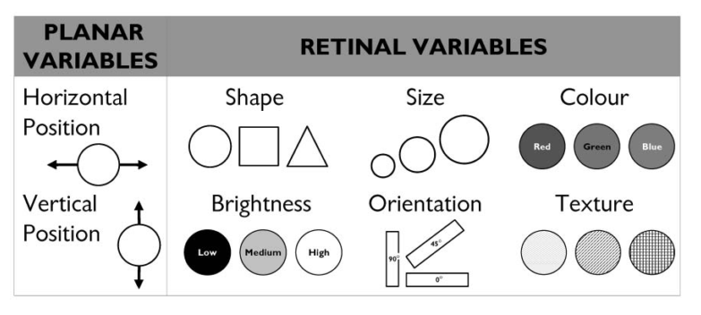
Recommendations
Physics of notations
Semiotic clarity
Perceptual Discriminality
Complexity Management
Semantics transparency
Cognitive Integration
Visual Expressiveness
Dual Coding
Graphic Economy
Cognitive Fit

Slide 94
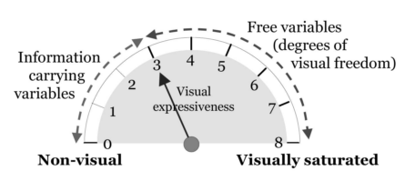
Recommendations
Physics of notations
Semiotic clarity
Perceptual Discriminality
Complexity Management
Semantics transparency
Cognitive Integration
Visual Expressiveness
Dual Coding
Graphic Economy
Cognitive Fit

Slide 95
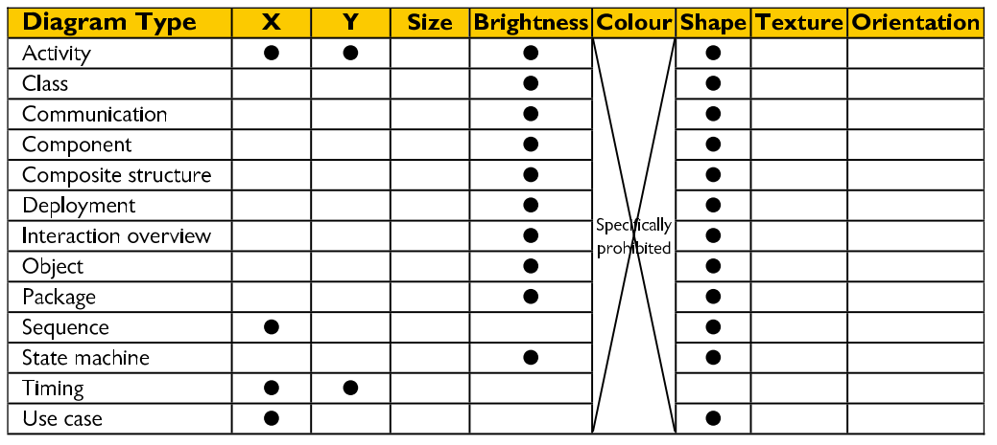
Recommendations
Physics of notations
Semiotic clarity
Perceptual Discriminality
Complexity Management
Semantics transparency
Cognitive Integration
Visual Expressiveness
Dual Coding
Graphic Economy
Cognitive Fit

Slide 96
Recommendations
Physics of notations
Semiotic clarity
Perceptual Discriminality
Complexity Management
Semantics transparency
Cognitive Integration
Visual Expressiveness
Dual Coding
Graphic Economy
Cognitive Fit
Use text to complement graphics

Slide 97
Recommendations
Physics of notations
Semiotic clarity
Perceptual Discriminality
Complexity Management
Semantics transparency
Cognitive Integration
Visual Expressiveness
Dual Coding
Graphic Economy
Cognitive Fit

Slide 98
Recommendations
Physics of notations
Semiotic clarity
Perceptual Discriminality
Complexity Management
Semantics transparency
Cognitive Integration
Visual Expressiveness
Dual Coding
Graphic Economy
Cognitive Fit
The number of different graphical symbols should be cognitively manageable

Slide 99
Recommendations
Physics of notations
Semiotic clarity
Perceptual Discriminality
Complexity Management
Semantics transparency
Cognitive Integration
Visual Expressiveness
Dual Coding
Graphic Economy
Cognitive Fit
Use different visual dialects for different tasks and audiences

Slide 100
Anatomy
DSL
Abstract Syntax
Concrete Syntax
Semantics
Textual
Graphical
Concepts & relationships
Well-formed rules
Denotational
Pragmatic
Translational
Operational

Slide 101
Semantics
Denotational
Use of mathematical formalisms
Complex
Pragmatic
Use of examples to illustrate the language
Input / outputs
Hard to deduce the real semantics
Traslational
Translation to other well-known language
Similar to compilation
Operational
Sequence of operations
Virtual machine

Slide 102
DSL
The big picture
Anatomy
Development
Actors
Best practices
Worst practices
What is a DSL? Why?

Slide 103
Development process
Decision
Analysis
Design
Implementation
Validation
Create a new one or reuse an existing one
Enable non-technical users to participate
Problem domain identified
Domain knowledge gathered from end-users
Domain model: Scope, vocabulary, concepts, commonalities and variabilities
Define the DSL components (abstract and concrete syntaxes, semantics)
Decide best approach to implement the language
Develop DSL components (Xtext, EMFText, GMF, etc…)
If it is executable, develop the corresponding interpreter or compiler
Test the language
Validate the language with the end-user

Slide 104
Regarding the implementation
External vs Internal
DSL
Grammar
Host Language
conforms To
Internal DSL 1
DSL
Text
DSL
Text
Internal DSL 2

Slide 105
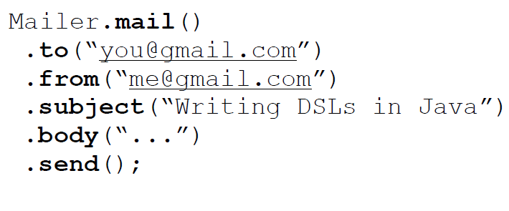
Internal DSL

Slide 106
External vs Internal
Internal
Simple
Limited
External
Flexible
Adapted
Complicated

Slide 107
DSL
The big picture
Anatomy
Development
Actors
Best practices
Worst practices
What is a DSL? Why?

Slide 108
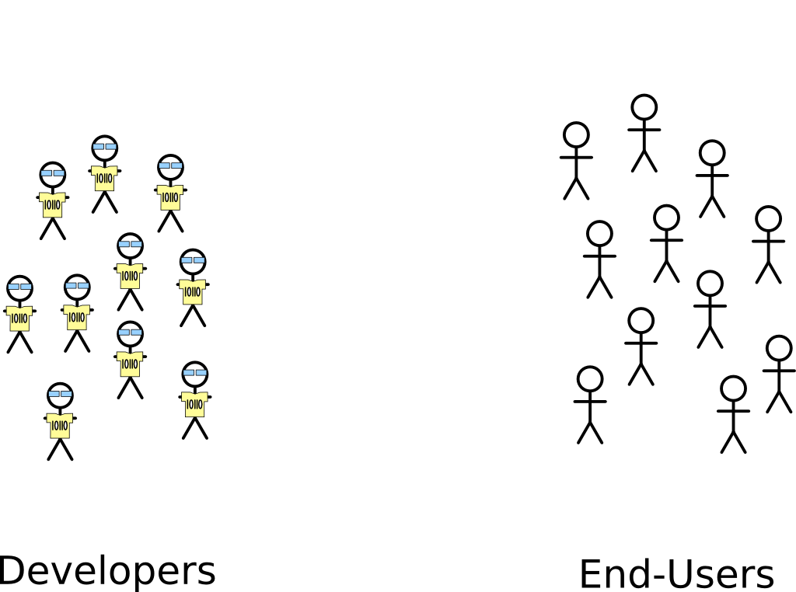
Actors

Slide 109
Actors
High
Domain Knowledge
Low
Low
Technical Level
High

Slide 110
DSL
The big picture
Anatomy
Development
Actors
Best practices
Worst practices
What is a DSL? Why?

Slide 111
Best practices
Limit Expressiveness
Tooling
Support
Learn from GPLs
Evolution
Viewpoints

Slide 112
DSL
The big picture
Anatomy
Development
Actors
Best practices
Worst practices
What is a DSL? Why?

Slide 113
Worst practices
Initial conditions
Only Gurus allowed
Believe that only gurus can build languages ir that “I’m smart and don’t need help”
Lack of Domain Understanding
Insufficiently understanding the problem domain or the solution domain
Analysis paralysis
Wanting the language to be theoretically complete, with its implementation assured

Slide 114
Worst practices
The source for Language Concepts
UML: New Wine in Old Wineskins
Extending a large, general-purpose modeling language
3GL Visual Programming
Duplicanting the concepts and semantics of traditional programming languages
Code: The Library is the Language
Focusing the language on the current code’s technical details
Tool: if you have a hammer
Letting the tool’s technical limitations dictate language development

Slide 115
Worst practices
The resulting language
Too Generic / Too Specific
Creating a language with a few generic concepts or too many specific concepts, or a language that can create only a few models
Misplaced Emphasis
Too strongly emphasizing a particular domain feature
Sacred at Birth
Viewing the initial language version as unalterable

Slide 116
Worst practices
Language Notation
Predetermined Paradigm
Choosing the wrong representational paradigm or the basis of a blinkered view
Simplistic Symbols
Using symbols that are too simple or similar or downright ugly

Slide 117
Worst practices
Language Use
Ignoring the use process
Failing to consider the language’s real-life usage
No training
Assuming everyone understands the language like its creator
Pre-adoption Stagnation
Letting the language stagnate after successful adoption

Slide 118
Outline
Languages
Domain-Specific Languages
Xtext
GMF

Slide 119
Xtext
Eclipse Project
Part of Eclipse Modeling
Part of Open Architecture Ware
Model-driven development of Textual DSLs
Part of a family of languages
Xtext
Xtend
Xbase
Xpand
Xcore

Slide 120
Eclipse Modeling Project

Slide 121
Eclipse Modeling Project

Slide 122
The grammar language
Corner-stone of Xtext
DSL to define textual languages
Describe the concrete syntax
Specify the mapping between concrete syntax and domain model
From the grammar, it is generated:
The domain model
The parser
The tooling

Slide 123
Main advantages
Consistent look and feel
Textual DSLs are a resource in Eclipse
Open editors can be extended
Complete framework to develop DSLs
Easy to connect to any Java-based language

Slide 124
Proposed development process
Create Xtext Project
Defining the DSL
Grammar definition
Workflow definition
Configure Fomatting (opt)
Configure Scoping (opt)
Generate DSL tooling
Configure validation (opt)
Configure generator

Slide 125
Example DSL
Poll System application
Define a Poll with the corresponding questions
Each question has a text and a set of options
Each option has a text
Generate the application in different platforms
DSL Tooling
Poll System Definition
Generator

Slide 126
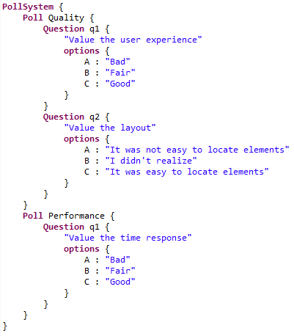
Example DSL
DSL Tooling
Generator

Slide 127
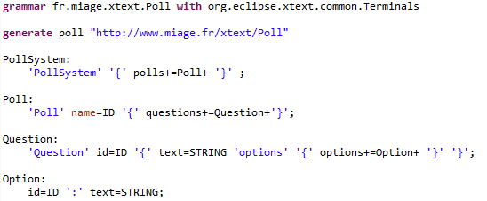
Grammar Definition
Grammar
definition

Slide 128
Grammar Definition
Grammar
reuse

Slide 129
Grammar Definition
Derived
metamodel

Slide 130
Grammar Definition
Parser Rules

Slide 131
Grammar Definition
Keywords

Slide 132
Grammar Definition
Multivalue asignment
Simple asignment
?= Boolean asignment

Slide 133
Grammar Definition
Cardinality (others: * ?)

Slide 134
Grammar Definition
Containment

Slide 135
Grammar Definition

Slide 136
Grammar Definition

Slide 137
Grammar Definition

Slide 138
Grammar Definition

Slide 139
Xtext Demo

Slide 140
Outline
Languages
Domain-Specific Languages
Xtext
GMF

Slide 141
GMF
Eclipse project
Eclipse Modelling components
Uses
EMF (Eclipse Modeling Framework)
GEF (Graphical Editing Framework)
Model-driven framework for Graphical DSLs
Everything is a model
Still under development (perpetual beta)
The only alternative for now
DSL definition easy, tweaking hard

Slide 142
Eclipse Modeling Project

Slide 143
Eclipse Modeling Project

Slide 144
Parts of GMF
Tooling
Editors for notation, semantic and tooling
GMF Dashboard
Generator to produce the DSL implementation
Runtime
Generated DSLs depend on the GMF Runtime to produce an extensible graphical editor

Slide 145
Main advantages
Consistent look and feel
Diagram persistence
Open editors can be extended by third-parties
Already integrated with various Eclipse components
Extensible notation metamodel to enable the isolation of notation from semantic concerns
Future community enhancements will easily be integrated

Slide 146
Proposed development process
Create GMF Project
Defining the DSL
Domain Model
Graphical Definition
Tooling Definition
Develop Mapping Model
Create Generator Model
Generate Diagram Plugin

Slide 147
Proposed development process

Slide 148
Defining a graphical DSL
Domain Model
Graphical Definition
Tooling Definition
Mapping Model

Slide 149
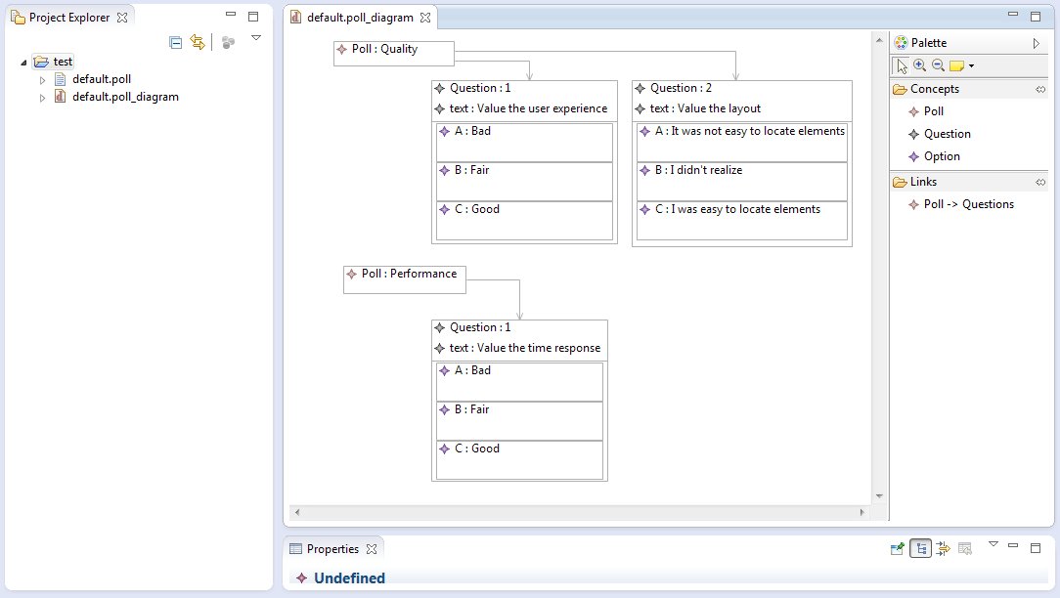
Example DSL

Slide 150
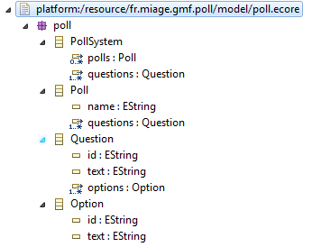
Domain Model
Concepts
PollSystem
Poll
Question
Option
Attributes
A Poll has a name
A Question has an identifier and a descriptive text
An Option has an identifier and a descriptive text
Relationships
PollSystem is composed of polls and questions
Question has a set of options

Slide 151
Graphical Definition
Defines the graphical representation of the DSL elements
Tree-based editor
Main elements
Node → DSL node
Connector → DSL link
Compartment → Node compartment (for complex nodes)
Label → The label of a Node, Connector or compartment
Figure descriptor → Graphical representation of a Node
Rectangle, ellipse, polygon,…
Polyline,…
Decorators, icons, …
Custom figures,…
Provides simple figures that they can be customized

Slide 152
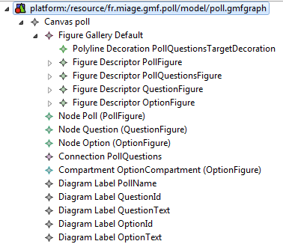
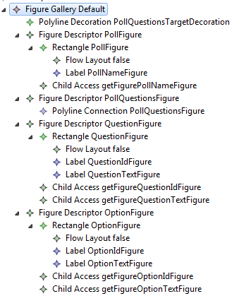
Graphical Definition
A model will represent a PollSystem
A Poll will be a node
A Question will be a rectangular node
An Option will be a rectangular node included in the Question node

Slide 153
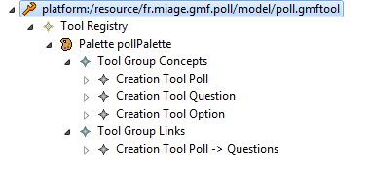
Tooling Definition
Defines the tooling to create the DSL elements in the editor
Tree-based editor
Main elements
Tool Group → Set of tools
Creation Tool → Tool for creating a DSL element (node, connector, etc,…)
Each tool can have an icon and a contextual help

Slide 154
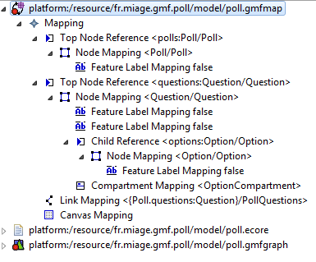
Mapping Model
Defines the correspondeces between model elements, graphical elements and tooling elements
Automatically generated (at least a kick-off version)
Tree-based editor
Main elements
Top Node Reference → Maps a concept of the root model element
Node Mapping → Maps a concept with the graphical node and tooling
Feature Label Mapping → Maps a concept attribute with the graphical label
Child Reference → Maps a containment reference with the compartment
Compartment Mapping → Maps a concet with the graphical node
Link Mapping → Maps a reference of the root model elements

Slide 155
GMF Demo

Slide 156
References
Kleppe, A.: Software Language Engineering
J. Bézivin, “Model Driven Engineering: An Emerging Technical Space,” in GTTSE conf., 2006, vol. 4143, pp. 36–64
M. Brambilla, J. Cabot, M. Wimmer. “Model-Driven Software Engineering in Practice”. Morgan & Claypool
M. Mernik, J. Heering, and A. M. Sloane, “When and how to develop domain-specific languages,” ACM Computing Surveys, vol. 37, no. 4, pp. 316–344, Dec. 2005.
Brambilla, M., Cabot, J., Wimmer, M.: Model-Driven Software Engineering in Practice
Y. Sun and Z. Demirezen, “Is My DSL a Modeling or Programming Language?,” in DSPD conf., 2008.
M. Strembeck and U. Zdun, “An approach for the systematic development of domain specific languages,” Software: Practice and Experience, vol. 39, pp. 1253–1292, 2009.
J.-M. Favre, “Foundations of Meta-Pyramids : Languages vs . Metamodels,” pp. 1–28.
J. De Lara and E. Guerra, “Languages for Model Driven Engineering,” in ECMDA conf., 2012, vol. 7349, pp. 259–274.
D. L. Moody, “The ‘physics’ of notations: Toward a scientific basis for constructing visual notations in software engineering,” Software Engineering, IEEE Transactions on, vol. 35, no. 6, pp. 756–779, Nov. 2009.
D. L. Moody and J. Van Hillegersberg, “Evaluating the visual syntax of UML: An analysis of the cognitive effectiveness of the UML family of diagrams,” in SLE conf., 2009, vol. 5452, no. Figure 1, pp. 16–34.
M. Völter, “MD */ DSL Best Practices Update March 2011,” 2011.
S. Kelly and R. Pohjonen, “Worst practices for domain-specific modeling,” IEEE Software, vol. 26, no. 4, pp. 22–29, 2009.
M. Völter, “DSL Engineering. Designing, Implementing and Using Domain-Specific Languages”.
I. Kurtev, J. Bézivin, and M. Aksit, “Technological Spaces : an Initial Appraisal,” in DOA, 2002, pp. 1–6.
Xtext Reference Guide
GMF documentation

